Slide 1




20/06/2025
CE7029
Numerical Modelling of Offshore Wind Turbines
Semester Project Report
Instructor:
Assoc. Prof. Dr. Elif Oğuz
Prepared By:
Bilge Kutay

Slide 2


01
Introduction
02
Pre-existing Model Analysis
Outline
03
Recreated Model Analysis
04
Conclusion
2

Slide 3


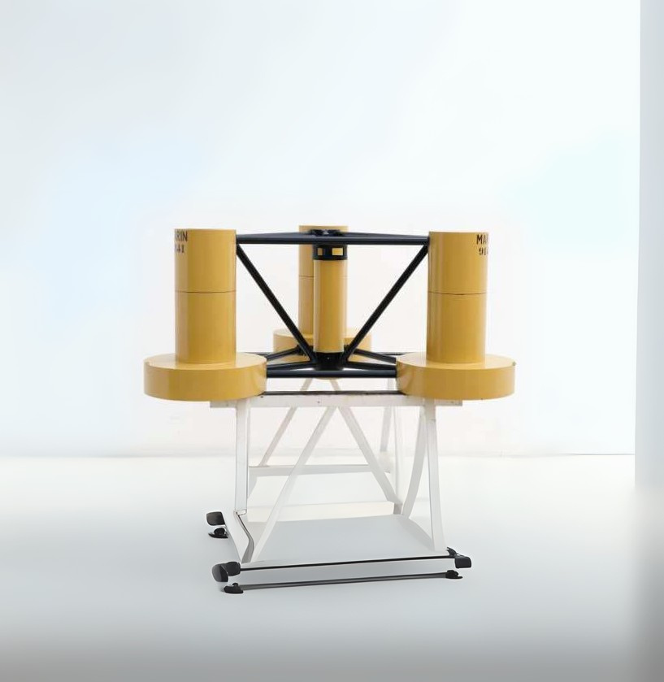
Introduction
Analysis of the OC4 semisubmersible platform
Two models: a pre-existing OpenFAST model and recreated model
The goal is comparison of both models under various load cases
Understanding FOWT dynamics and validate modeling approaches
3

Slide 4

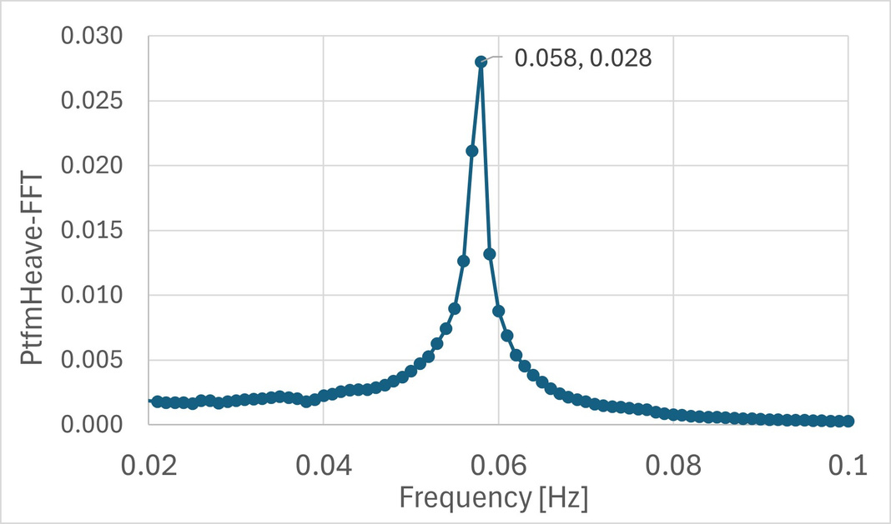

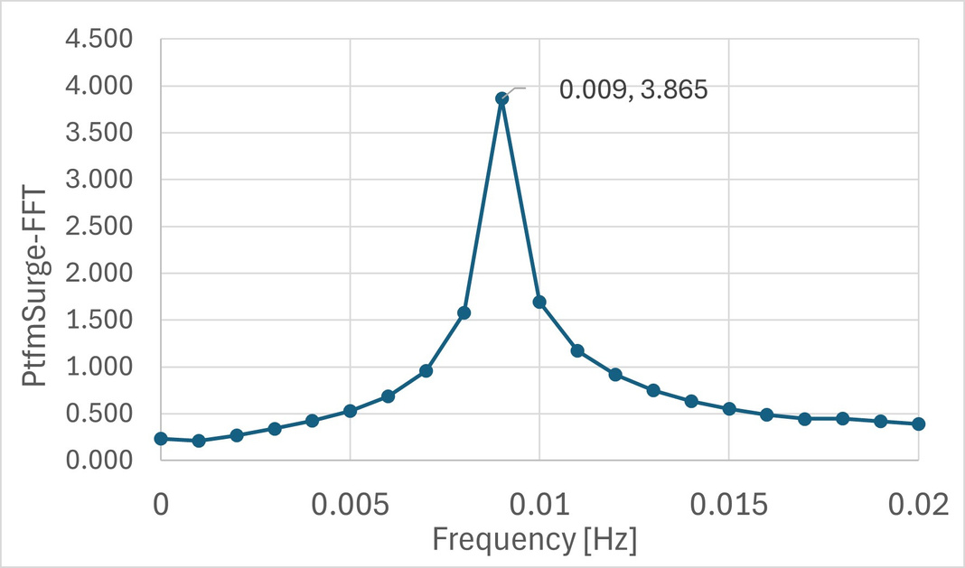

Pre-existing Model
Analysis - Free Decay
Free decay tests
Natural frequencies obtained by using FFT
Heave, roll, pitch: Higher frequency due to bouyancy and shifting forces
Surge, sway, yaw: Lower frequencies, dependent on mooring system
Only major difference is in surge and pitch
4

Slide 5
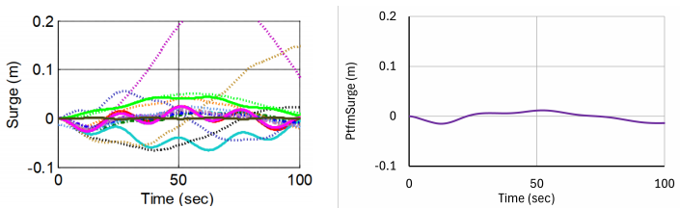


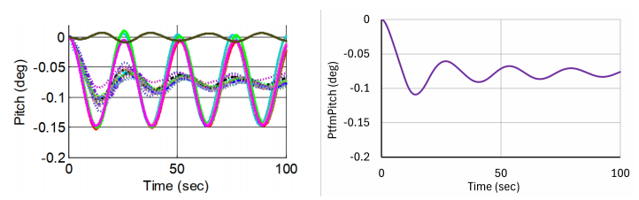
5

Slide 6
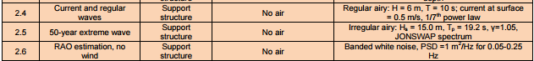
Pre-existing Model Analysis:
Wave and Current Induced Tests
Analysis across various wave and current conditions
Impact of second-order effects (QTF)
6

Slide 7

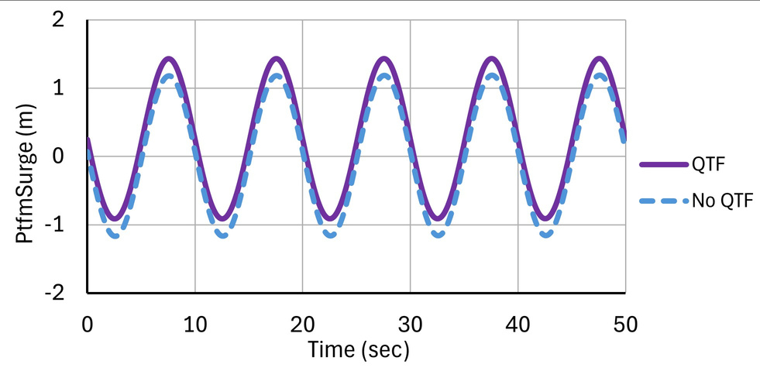
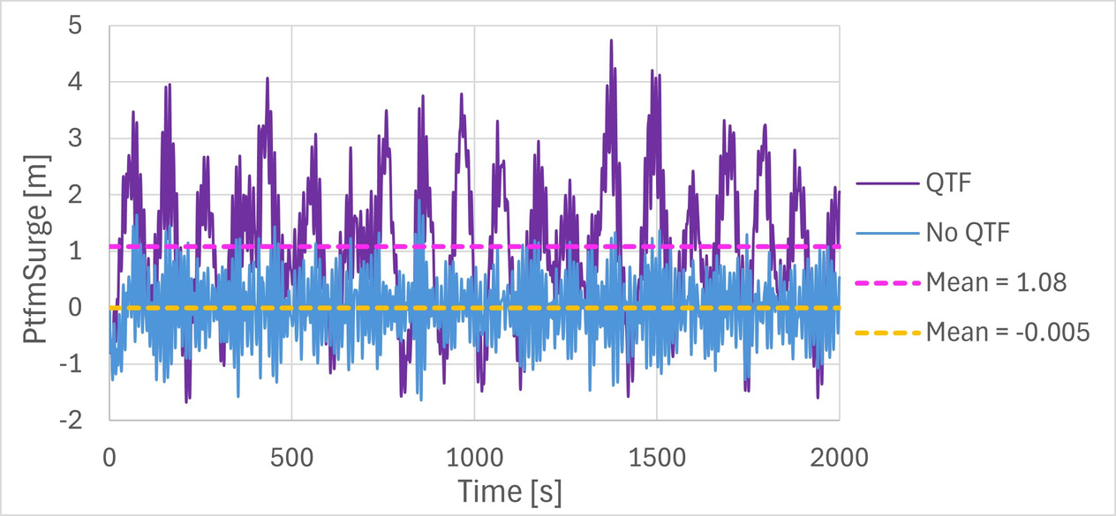

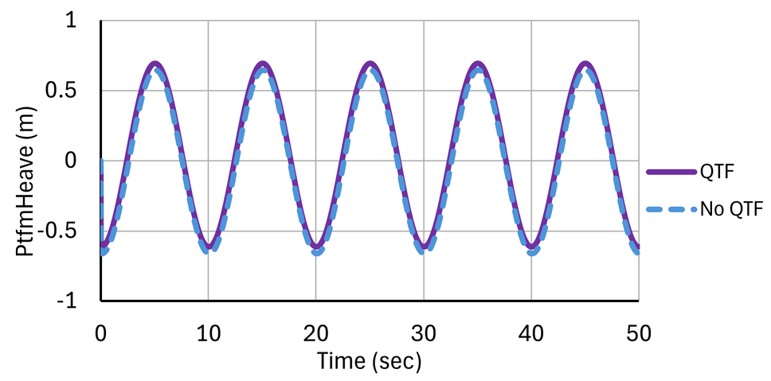
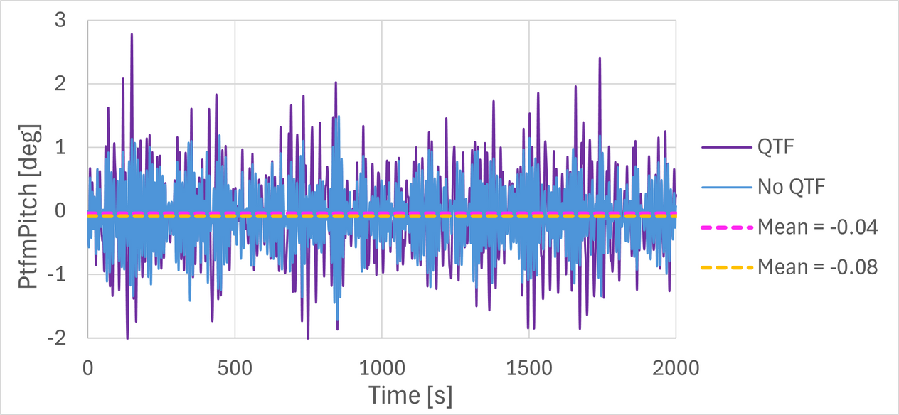
Load Case 2.1
Load Case 2.2
Customer Satisfaction
Revenue Growth
Employee Development
7

Slide 8
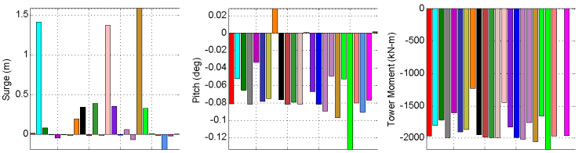
8

Slide 9
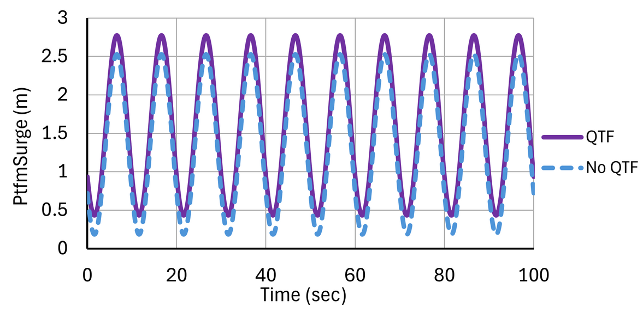
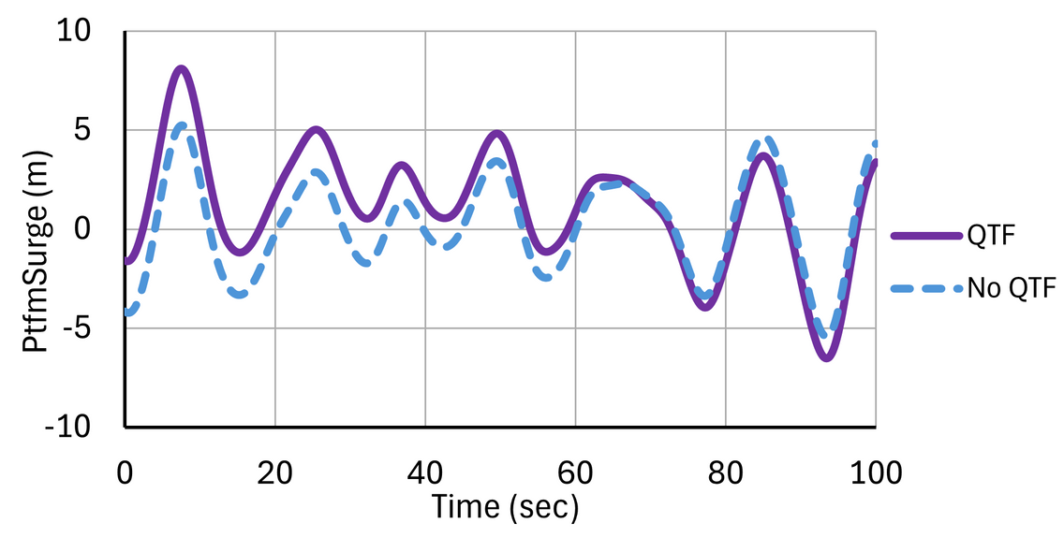
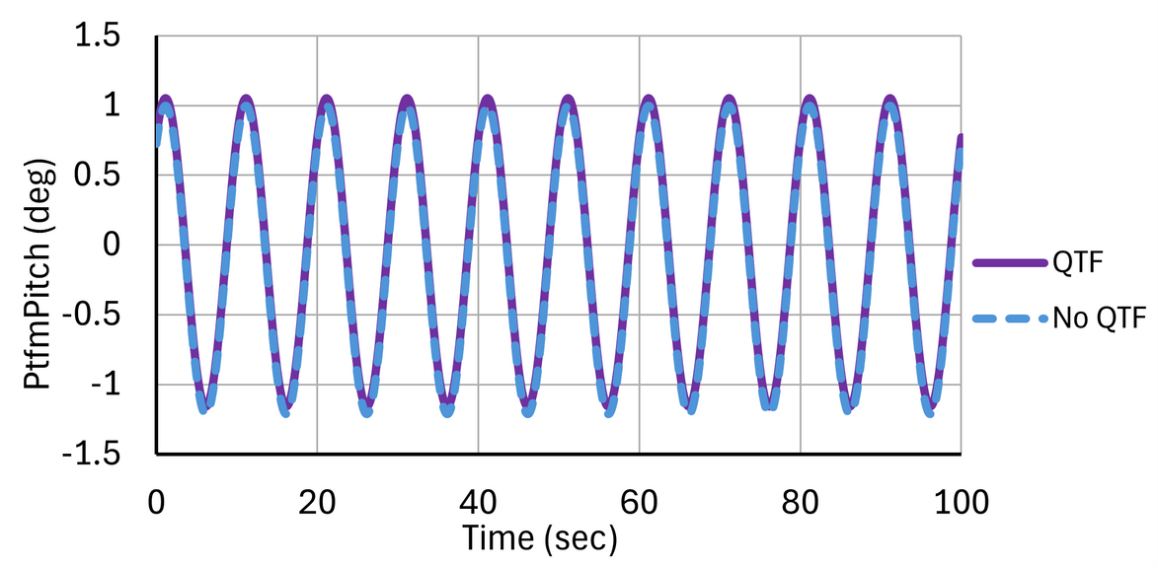
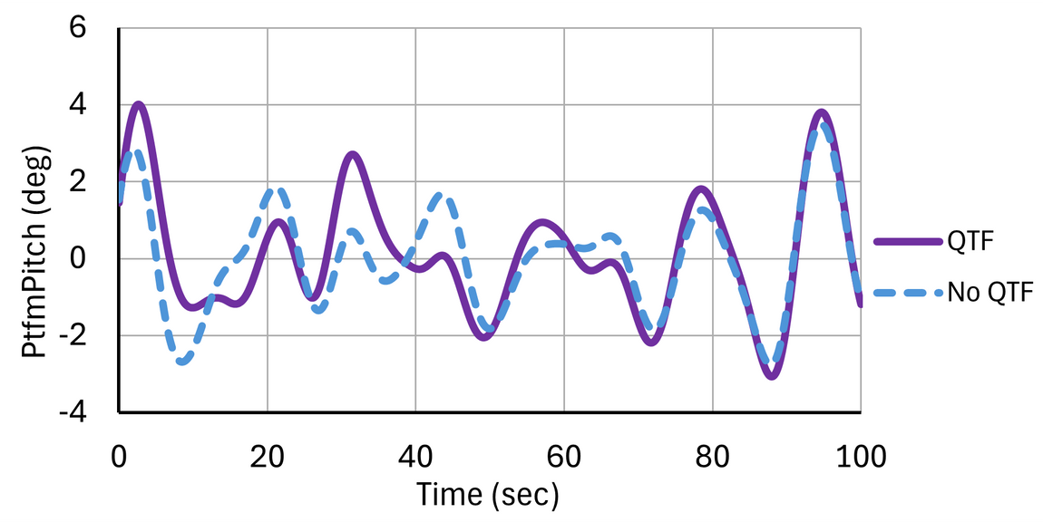
Load Case 2.4
Load Case 2.5
Customer Satisfaction
Revenue Growth
Employee Development
9

Slide 10


Load Case 2.6
Analyzed the Response Amplitude Operators (RAOs)
Represent the ratio of the systems response to the wave amplitude
Most important is the wave excitation range between 0.05-0.25 Hz
Natural frequency in this range means there is a risk of resonance
10

Slide 11
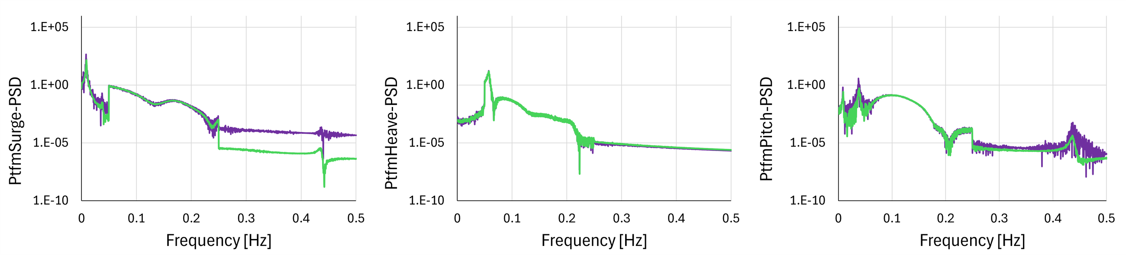

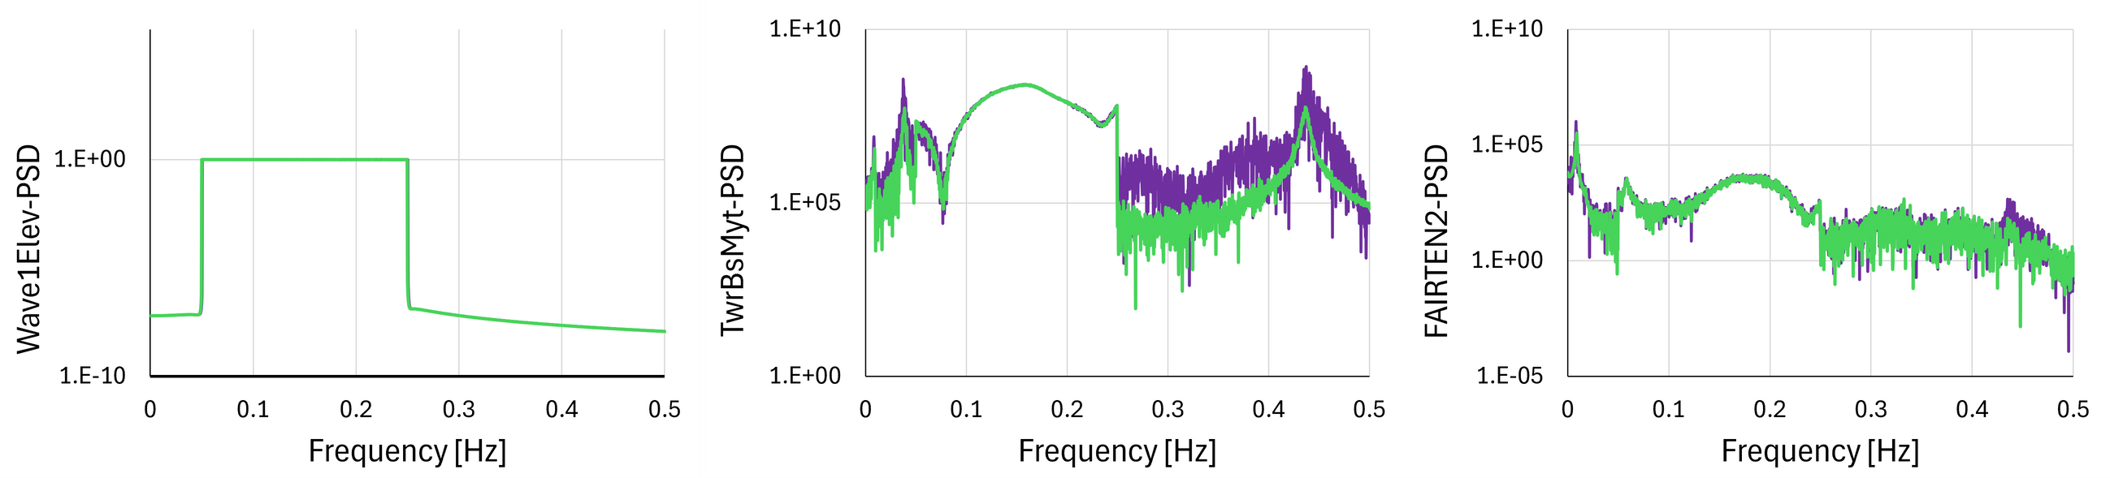
Load Case 2.6
0.058 Hz
11

Slide 12
Pre-existing Model Analysis:
Wave and Wind Induced Tests
Analysis of load cases 3.1 and 3.2
Impact of second-order effects (QTF)
12

Slide 13
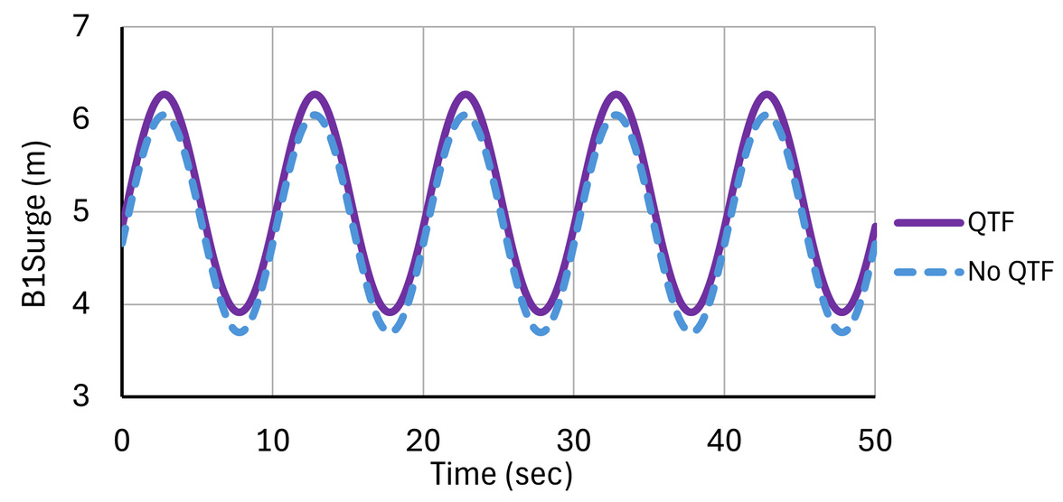
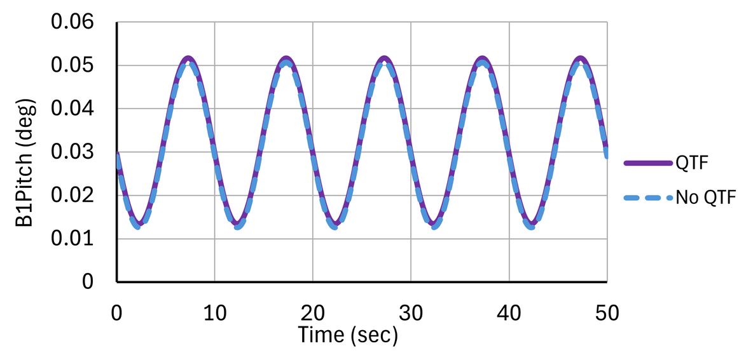
Load Case 3.1
Used not just the platform, but the whole system including mooring lines, platform, tower and blades
The same conclusion can be observed for the surge motion
Solution 3
13

Slide 14
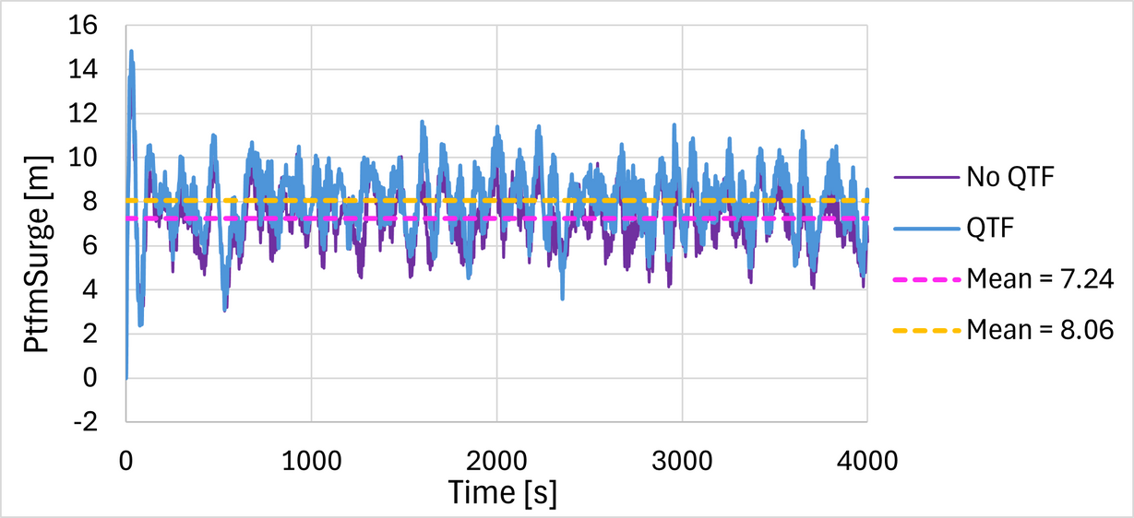
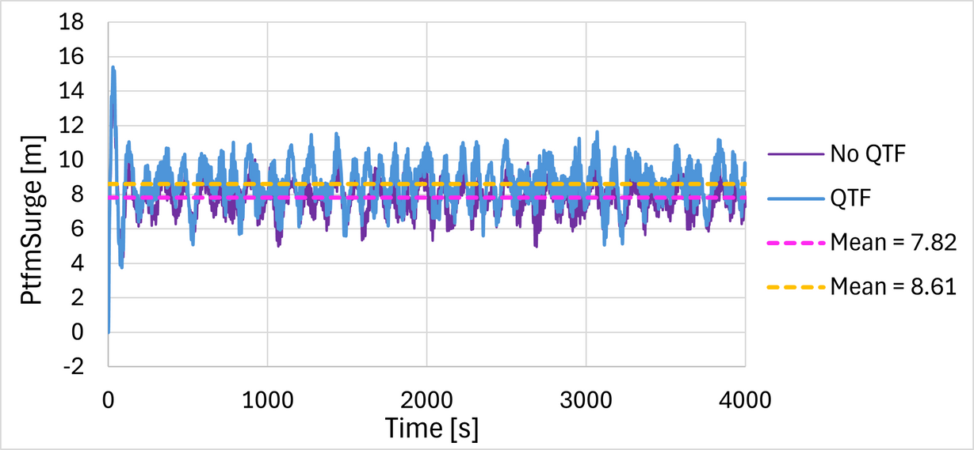
Load Case 3.2
Used two turbulence simulators:
TurbSim and IEC Turbulence Simulator
Differences were small enough to be negligable
Surge motion still showed higher difference in the QTF case
14

Slide 15
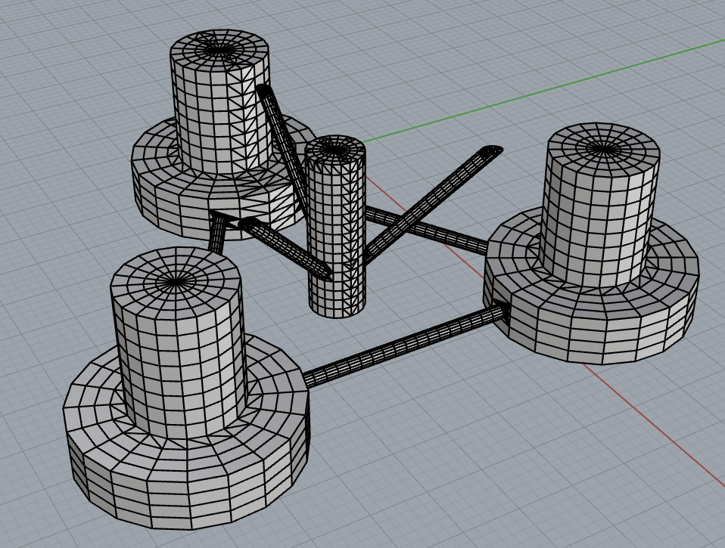
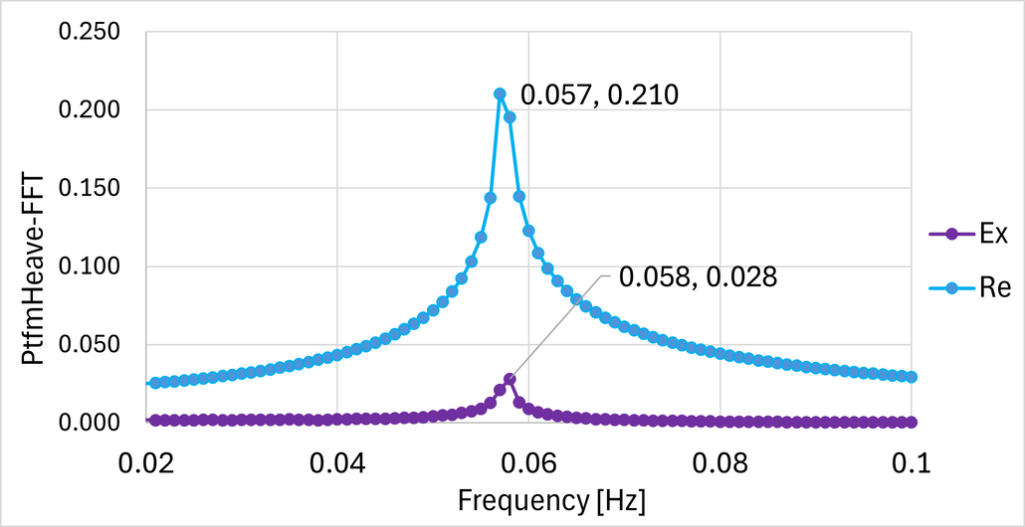
Recreated Model
Analysis - Free Decay
Same loading tests were done on the recreated model
The natural frequencies of the model were found to be almost identical
15

Slide 16
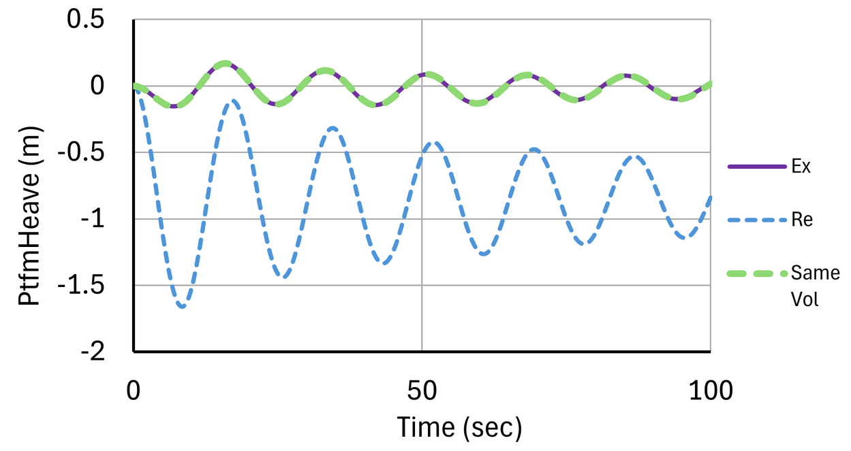
Free decay plots were very similar
Volume plays a big role in heave response
Recreated model ~300 m3 smaller than the pre-exising model
When the volume is taken as the same, plots become identical
16

Slide 17
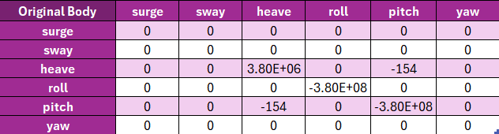
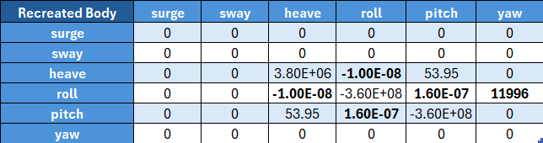
17

Slide 18
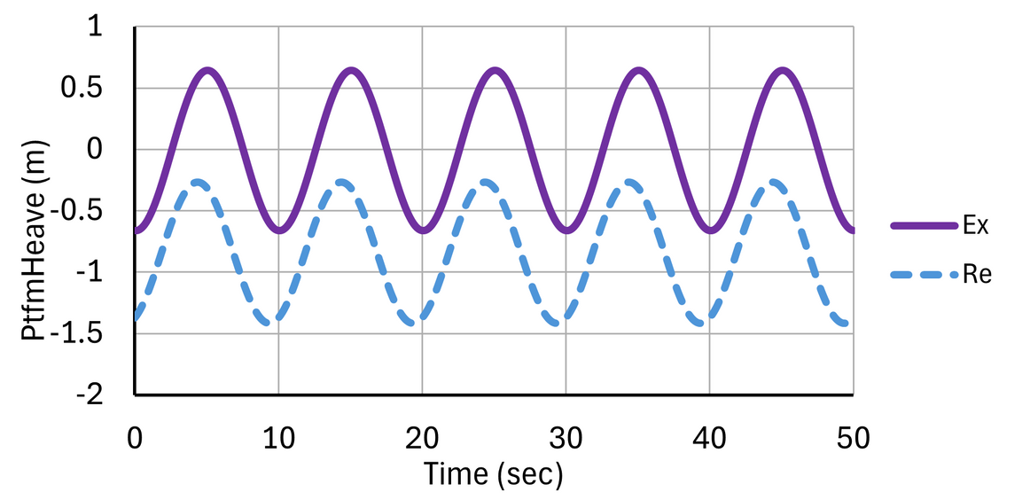
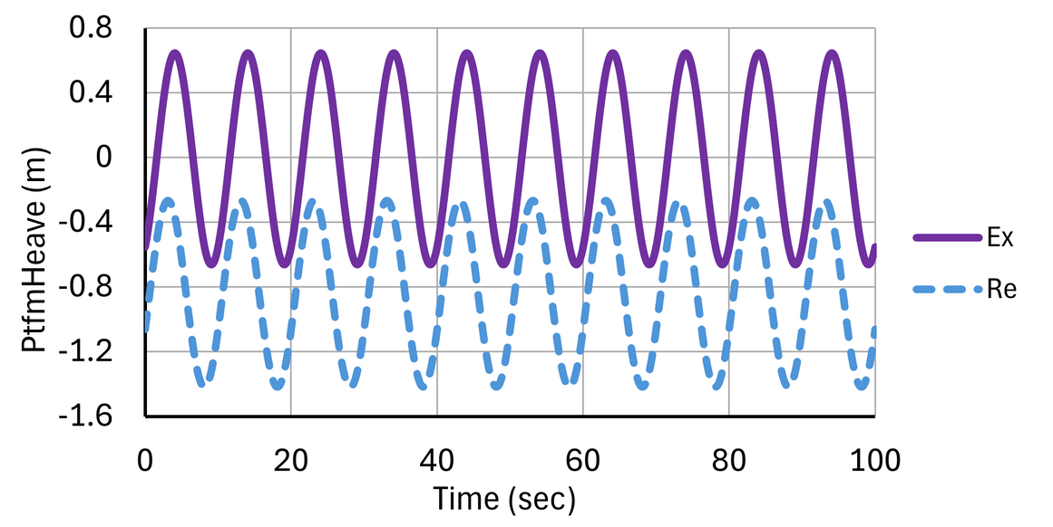
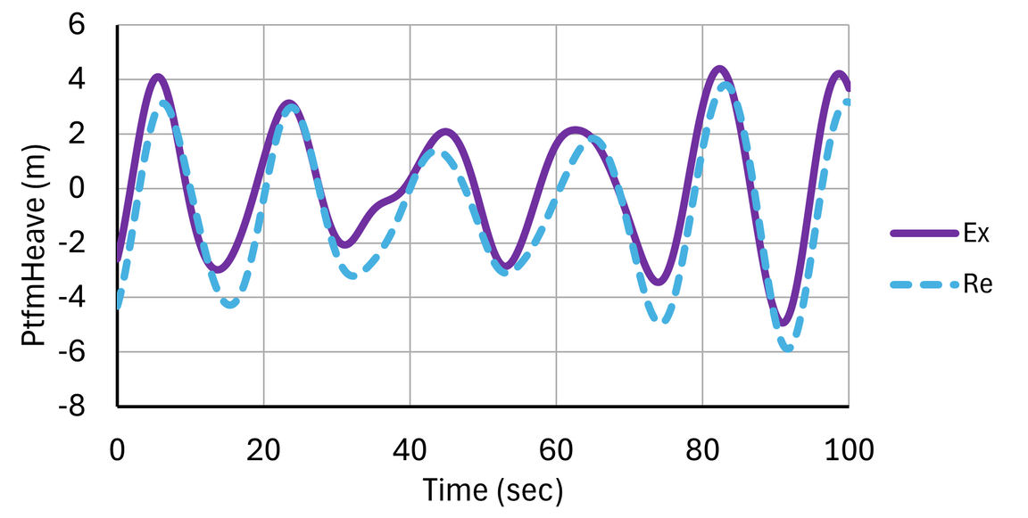
Load Cases 2.1-2.5
The plots for the models are very similar
The heave response is quite different due to volume
Load Case 2.1
Load Case 2.4
Load Case 2.5
18

Slide 19
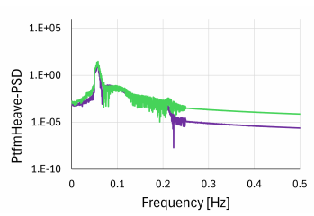
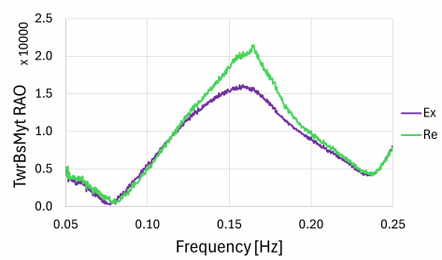
Load Case 2.6
Two noticable differences:
- Heave PSD plot not being perfectly aligned
- Tower bending RAO being higher, caused wby the coupling effects and geometry wdifferences
19

Slide 20
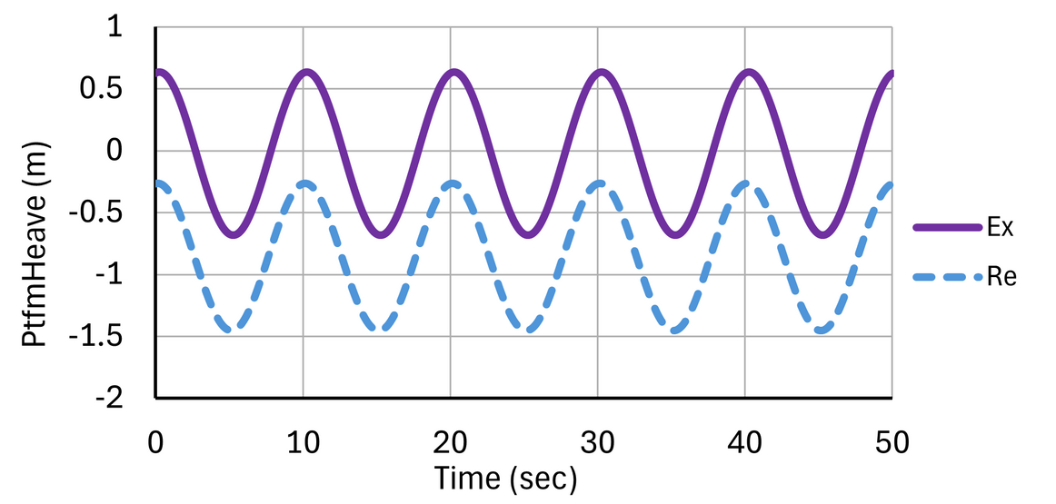
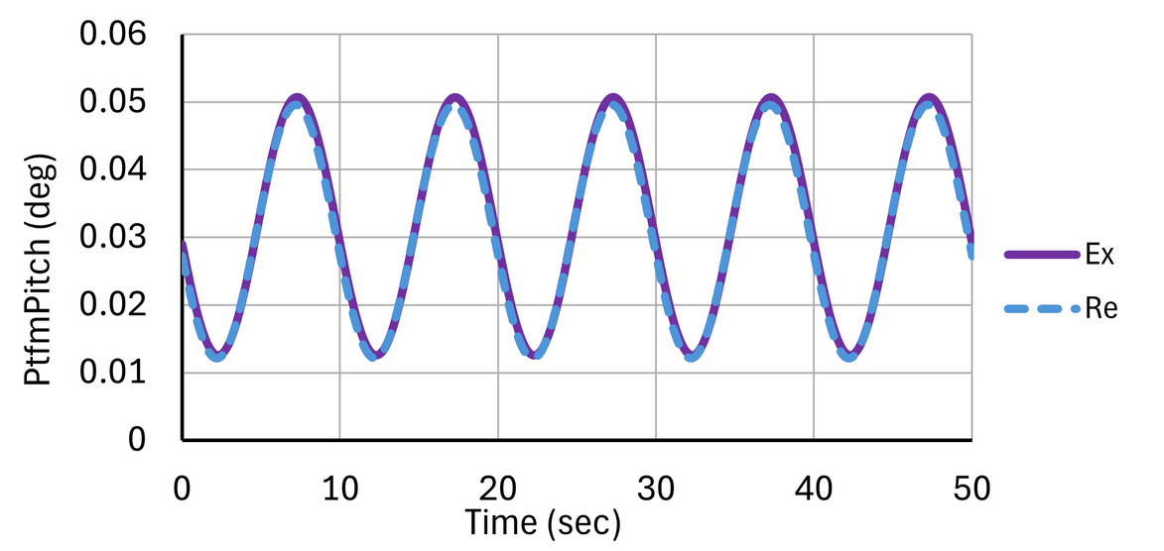
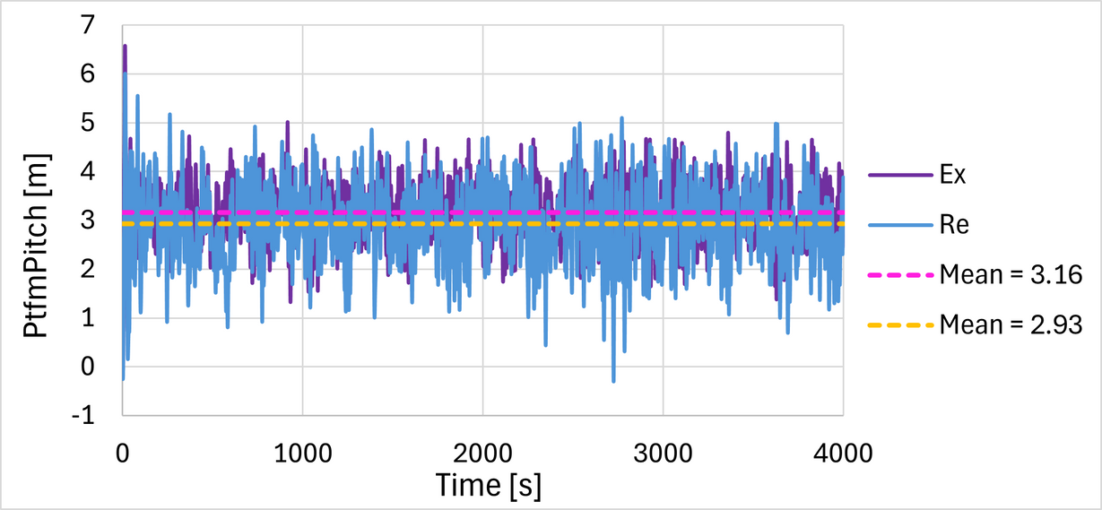
Load Cases 3.1-3.2
Outputs are very similar
In 3.2, the IEC Turbulance Simulator showed different results with the highest deviation being ~7%
20

Slide 21
Conclusion
2014 reference paper provided a foundation for code-to-code verification and stepped approach
Important to expand by implementing modern modeling tools
Supporting the continued effort to improve accuracy, safety and reliability of offshore wind systems
Solution 3
21

Slide 22
References
Robertson, A. N., Jonkman, J., and Musial, W. (2014). OC4-DeepCwind Semi-wwSubmersible Baseline Control System Design. National Renewable Energy wwLaboratory (NREL), Golden, CO.
Jonkman, J. M. (2007). Dynamics modeling and loads analysis of an offshore wwfloating wind turbine (Technical Report NREL/TP-500-41958). National wwRenewable Energy Laboratory. wwhttps://www.nrel.gov/docs/fy07osti/41958.pdf
Faltinsen, O. M. (1990). Sea loads on ships and offshore structures. Cambridge wwUniversity Press.
Solution 3
22

Slide 23


Thank you for your attention!
Do you have any questions?
23

